Slide 1

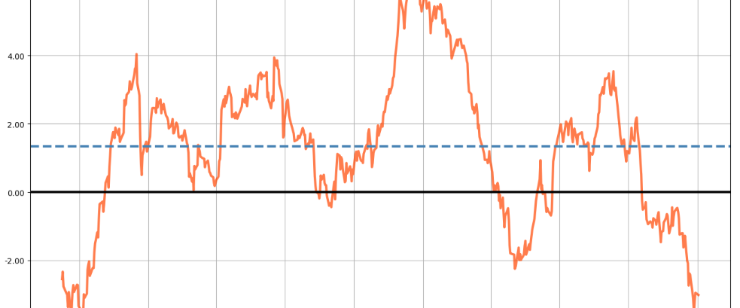
MHI Portfolios

Slide 2
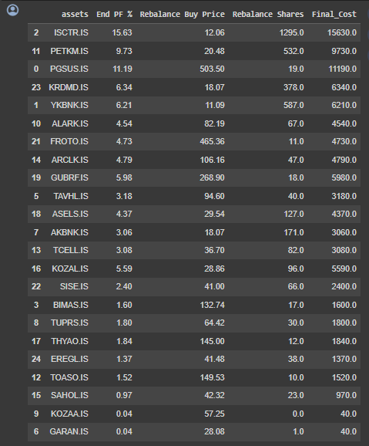
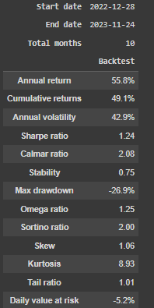
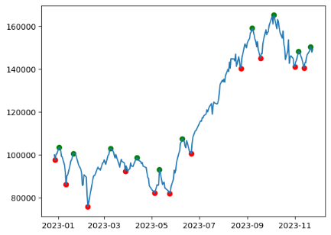
An optimized portfolio for 28.12.2022 – 24.12.2023

Slide 3
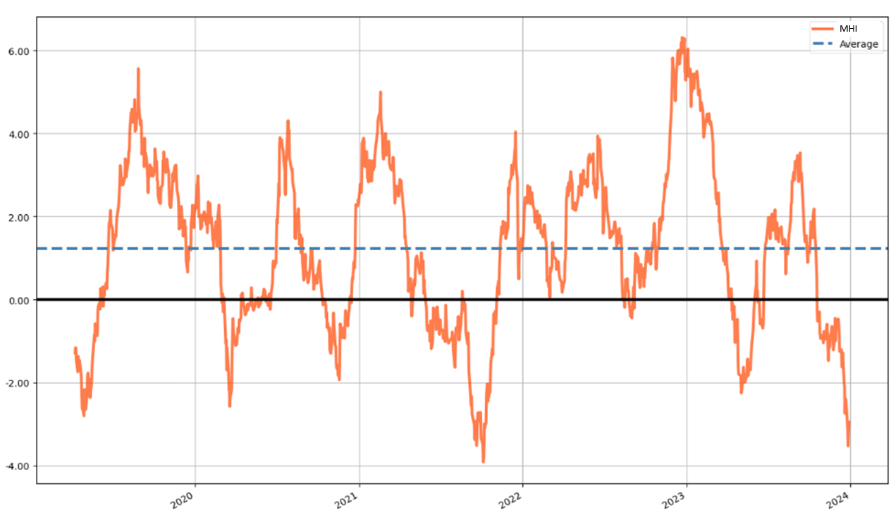
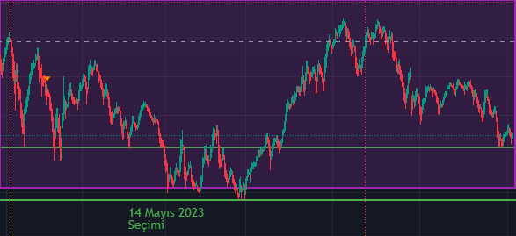
Market Health Index (MHI) - A mean-reverting index for trend detection
MHI on BIST30
Downtrend Uptrend
PREV UPTREND
23.08.2021 – 21.09.2022 21.09.2021 – 16.12.2021 (I)
16.12.2021 – 24.02.2022 24.02.2022 – 07.06.2022 (II)
07.06.2022 – 16.08.2022 16.08.2022 – 27.12.2022 (III)
27.12.2022 – 09.05.2023 09.05.2023 – 11.09.2023 (IV)
11.09.2023 – 26.11.2023 NEXT UPTREND
BIST100 – last 1 year
Last 5 years >>

Slide 4
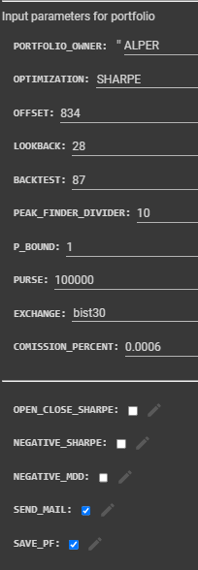
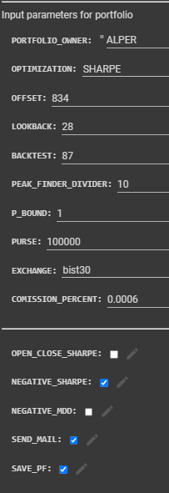
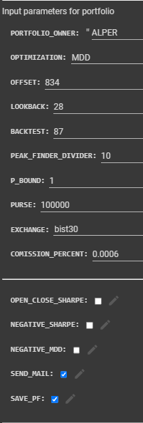
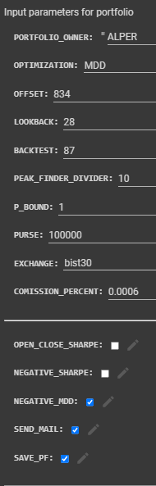
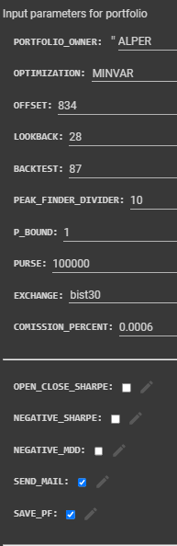
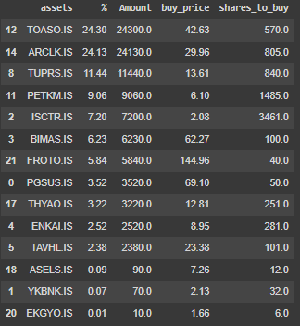

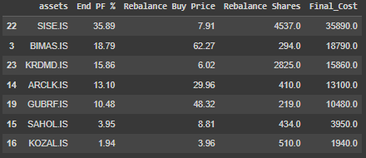

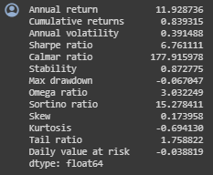
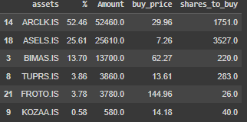
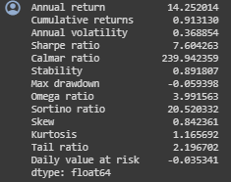
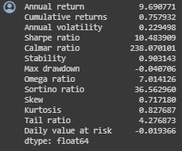
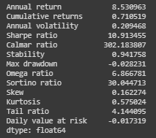
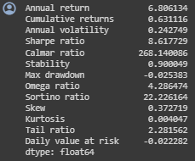
MHI portfolios for 21.09.2021 – 16.12.2021 (I)
Sharpe i-Sharpe MDD i-MDD MINVAR
Return: %91.3
SR: 7.6
MDD: %5.93
Return: %83.9
SR: 6.76
MDD: %6.7
Return: %75.8
SR: 10.48
MDD: %4
Return: %63.1
SR: 8.61
MDD: %2.53
Return: %71.1
SR: 10.91
MDD: %2.82

Slide 5
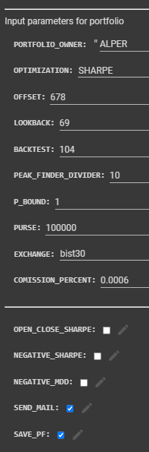
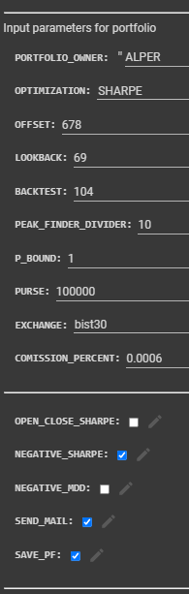
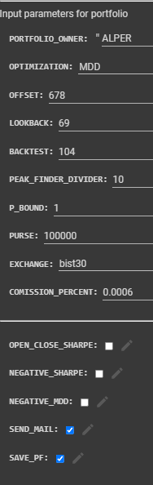
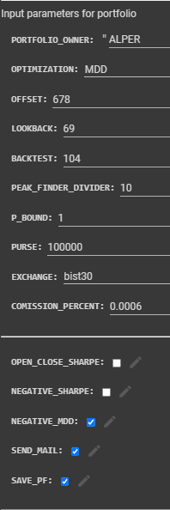
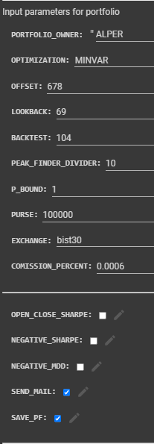

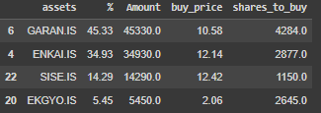


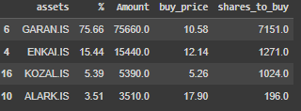
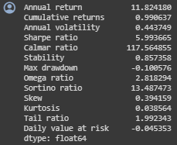
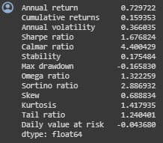
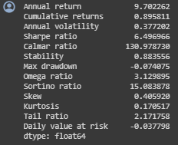
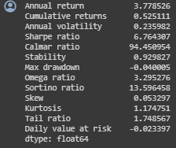
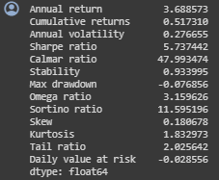
MHI portfolios for 24.02.2022 – 07.06.2022 (II)
Sharpe i-Sharpe MDD i-MDD MINVAR
Return: %99
SR: 5.99
MDD: %10.0
Return: %15.93
SR: 1.67
MDD: %16.58
Return: %89.6
SR: 6.49
MDD: %7.40
Return: %52.5
SR: 6.76
MDD: %4.0
Return: %51.7
SR: 5.73
MDD: %7.68

Slide 6
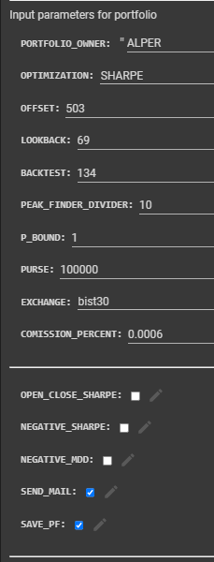
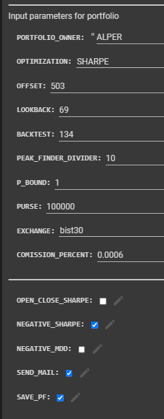
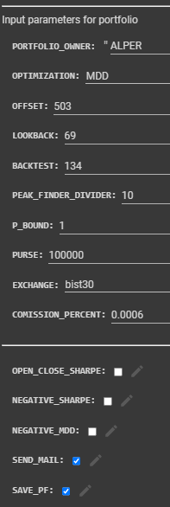
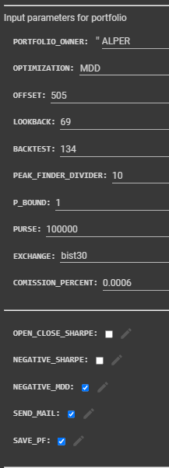
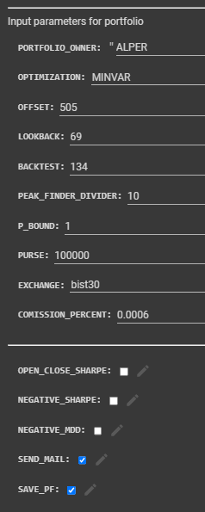
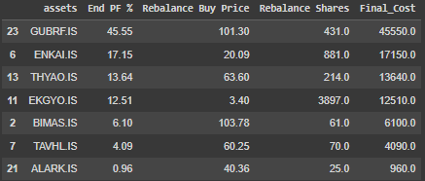
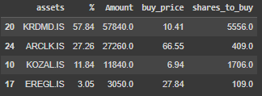
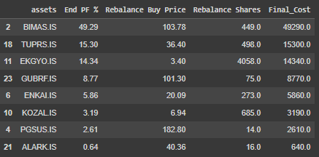

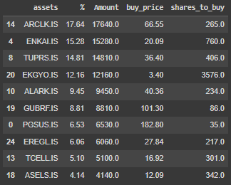
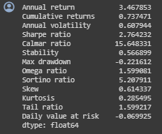
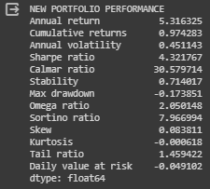
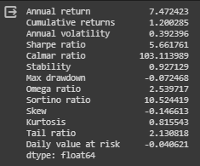
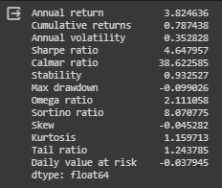
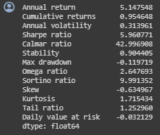
MHI portfolios for 16.08.2022 – 27.12.2022 (III)
Sharpe i-Sharpe MDD i-MDD MINVAR
Return: %73.7
SR: 2.76
MDD: %22.2
Return: %120
SR: 5.66
MDD: %7.2
Return: %97.4
SR: 4.32
MDD: %17.4
Return: %78.7
SR: 4.64
MDD: %9.9
Return: %95.5
SR: 5.96
MDD: %12.0

Slide 7
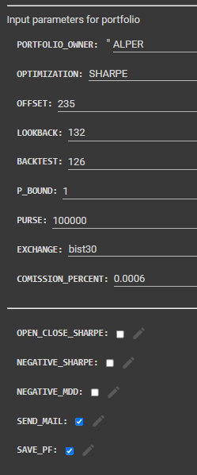
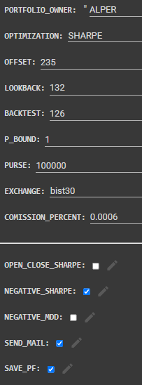
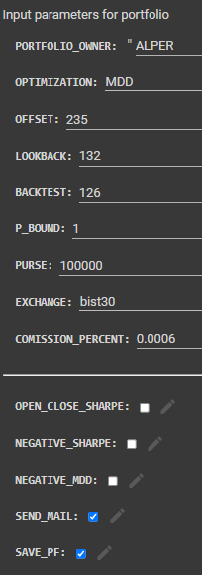
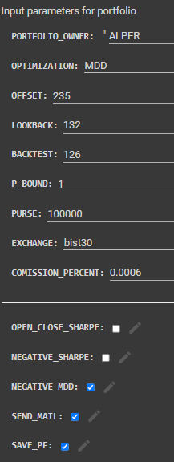
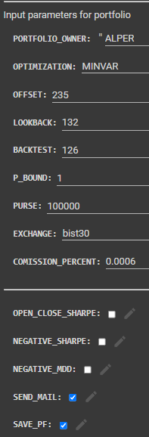










MHI portfolios for 09.05.2023 – 11.09.2023 (IV)
Sharpe i-Sharpe MDD i-MDD MINVAR
Return: %56.6
SR: 2.75
MDD: %13.7
Return: %65.6
SR: 3.39
MDD: %11.4
Return: %80.4
SR: 3.96
MDD: %16.1
Return: %64.3
SR: 3.96
MDD: %17.8
Return: %92.3
SR: 4.82
MDD: %12.4

Slide 8
Procedure for Portfolio Construction
Calculate and plot 5 year-MHI
Detect peaks (MHI > 4) and valleys (MHI < -2)
Apply Correlation filter
At the valleys, starting from latest peak calculate portfolio and enter that portfolio.
At the first peak, sell the portfolio.

Slide 9

Filter for Correlation

Slide 10

Filter for Volatility

Slide 11


PORTFÖY | BAŞLANGIÇ | BİTİŞ | KAR
MHI SHARPE-ALTIN KONSOLİDE | 27.12.2022 | 26.12.2023 | 115,45%
MHI SHARPE-ALTIN KONSOLİDE | 16.12.2021 | 26.12.2023 | 891,79%
MHI SHARPE-ALTIN KONSOLİDE | 21.09.2021 | 26.12.2023 | 1797,30%
MHI MDD-ALTIN KONSOLİDE | 27.12.2022 | 26.12.2023 | 164,57%
MHI MDD-ALTIN KONSOLİDE | 16.12.2021 | 26.12.2023 | 842,53%
MHI MDD-ALTIN KONSOLİDE | 21.09.2021 | 26.12.2023 | 1512,67%
GR ALTIN | 27.12.2022 | 26.12.2023 | 78,25%
GR ALTIN | 16.12.2021 | 26.12.2023 | 126,67%
GR ALTIN | 21.09.2021 | 26.12.2023 | 293,92%
USDTRY | 27.12.2022 | 26.12.2023 | 57,15%
USDTRY | 16.12.2021 | 26.12.2023 | 97,90%
USDTRY | 21.09.2021 | 26.12.2023 | 240,00%

